Slide 1
EDI Data Charter
via Plotly Express
David Pittman

Slide 2

Introduction
A graphical display of Electronic Data Interchange (EDI) messages represented by Sender, Receiver, Document Type, and Date

Slide 3
What is EDI?
“Electronic Data Interchange (EDI) is the computer-to-computer exchange of business documents in a standard electronic format between business partners” (What is EDI).

Slide 4
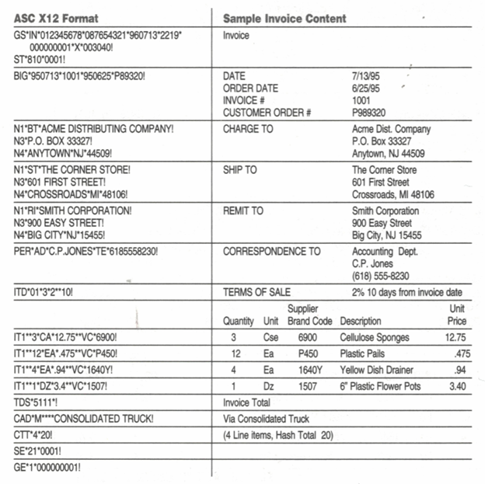
What does EDI look like?
This is an example Invoice that bills for a product or services rendered.
For each file processed, an ST to SE segment is a “message”.
Fig. 1.Jilovec, Nahid. EDI ASC12 Format and Sample Invoice. 1998. The A to Z of EDI.

Slide 5







Technology
Linux on Google Cloud Platform
Python & Plotly Express
HTML
Perl (Practical Extraction and Reporting Language) & BASH (Borne Again Shell)

Slide 6

Build Highlights
Data Source sanitization and CSV creation
Perl/HTML CGI web page creation
Working with Plotly Express and Iterative tests

Slide 7

CSV Dataset – archive.csv
Interchange Sender,Interchange Receiver,Interchange Control Number,Interchange Timestamp,Group Sender,Group Receiver,Group Type,Group Control Number,Group Version,Message Type,Message Count,Message Segments,Content Size,Year,Month,Day,Week of Year,Day Name
ZZ:WMT,ZZ:AMZN,000007418,2009-01-05 11:12:00,WMT,AMZN,PO,5209,004010,850,3,40,3172,2009,01,05,01,Monday

Slide 8
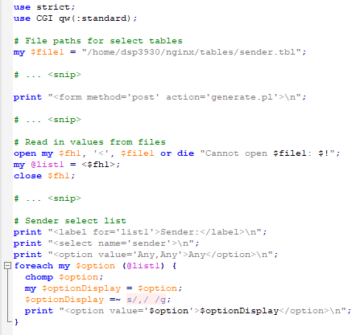
Archive.pl
Dyamically creates form from table files
Submits collected values to generate.pl

Slide 9
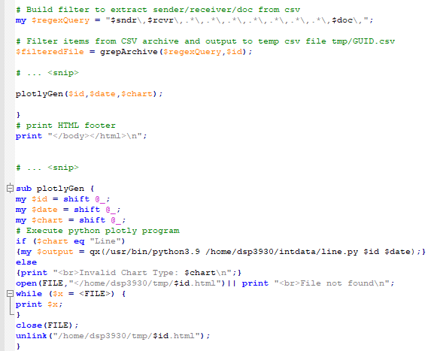
Generate.pl
Receives form values from archive.pl
Filters archive.csv based on form values
Passes UUID and date to subroutine exec of line.py
Html document from line.py displayed

Slide 10
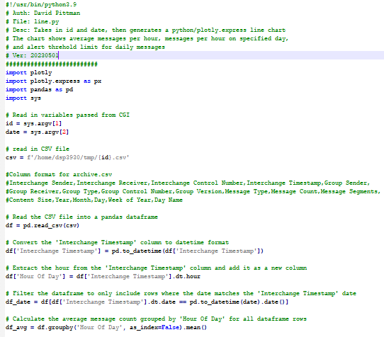
Line.py (Part 1)
Accepts child call from generate.pl to generate line chart for display to webpage.

Slide 11
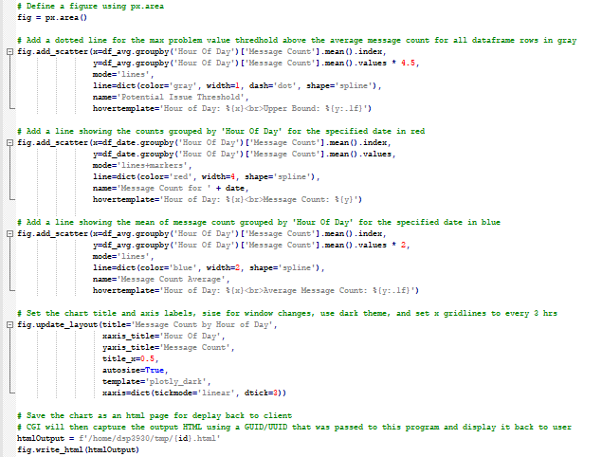
Line.py (Part 2)
Accepts child call from generate.pl to generate line chart for display to webpage.

Slide 12
Solution Demo

Slide 13
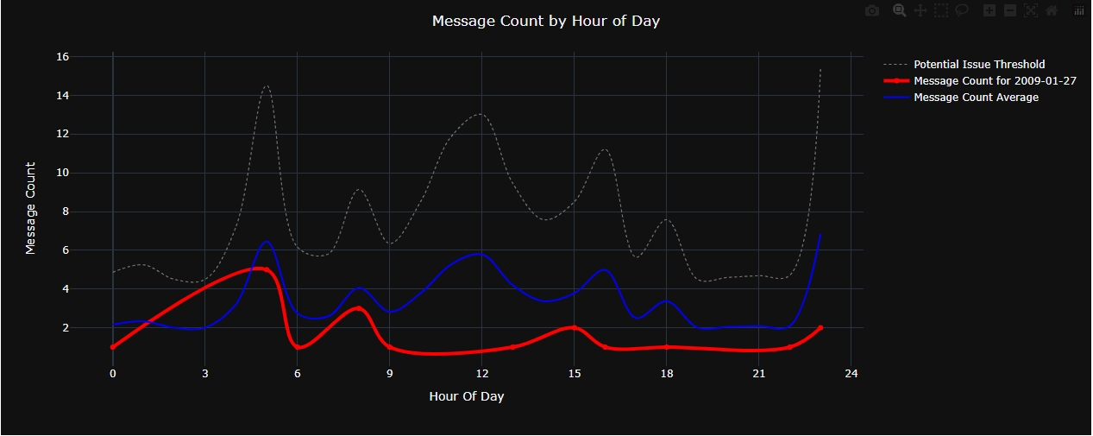
A Normal Day
In the video on the next slide, we can see what a normal day of received 850/Purchase Orders looks like.
Red Line = Day of Interest
Blue Line = Same weekday avg.
Grey Line = Potential Issue Threshold

Slide 14
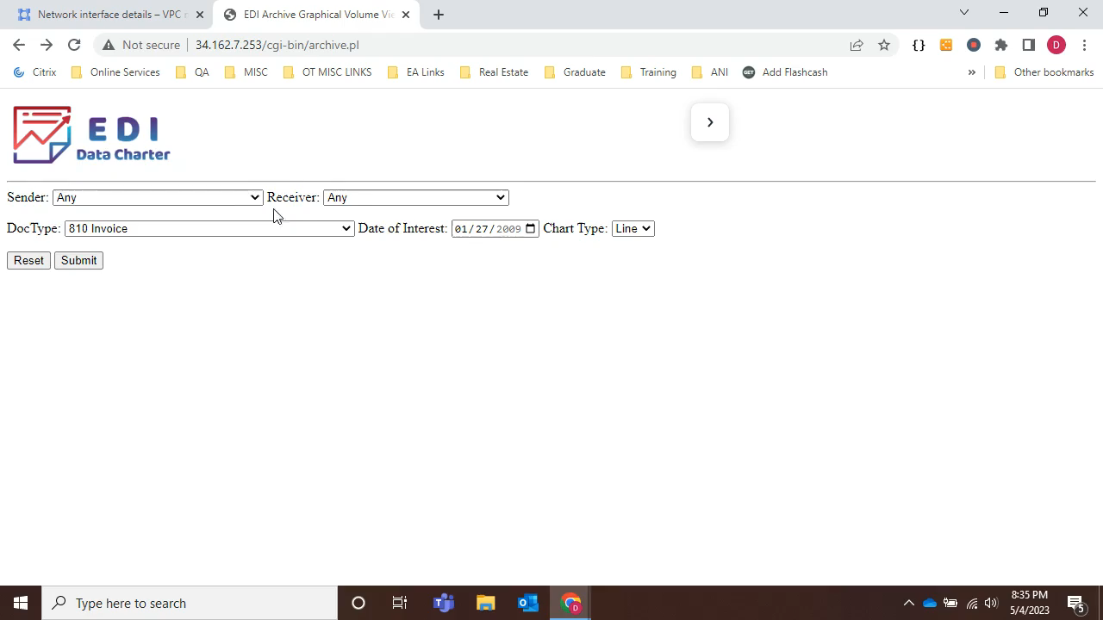

Slide 15
Explore a Normal Day
Click on the link at the bottom right to explore an interactive Plotly Express html page for a normal day.

Slide 16
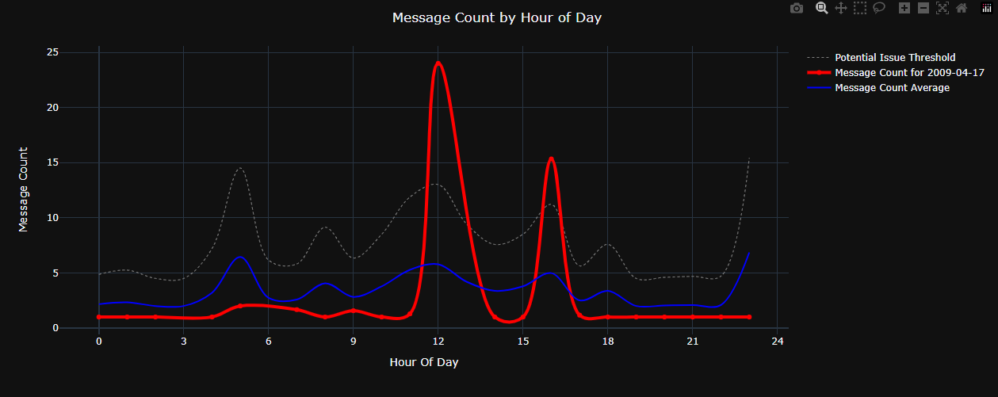
An Abnormal Day
In the video on the next slide, we can see what an abnormal day of received 850/Purchase Orders looks like. (Note: Red crosses Grey)
Red Line = Day of Interest
Blue Line = Same weekday avg.
Grey Line = Potential Issue Threshold

Slide 17
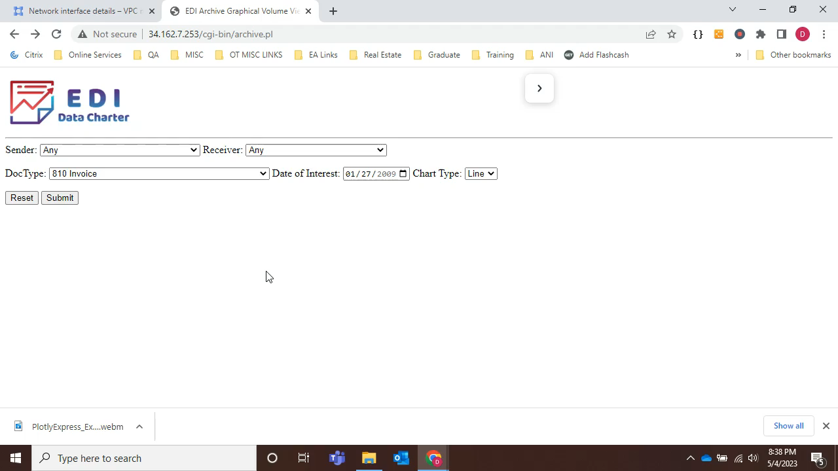

Slide 18
Explore an Abnormal Day
Click on the link at the bottom right to explore an interactive Plotly Express html page for an abnormal day.

Slide 19
Thank You!
This presentation is licensed for display and use by Kent State University for the purpose of showcasing projects to other students.

Slide 20
References
What is EDI (Electronic Data Interchange)? n.d. 05 May 2023. <https://www.edibasics.com/what-is-edi>.

